Slide 1
AI Agent for Document Interaction
Presented By: G. Susmitha
College Name & Department: Centurion university of Technology and Management
(CSE-CSBS)

Slide 3
Problem Statement
Challenges Faced:
- Overwhelming volume of documents
- Difficulty finding relevant info
- Time-consuming manual review
Need for a Solution:
- Tool to streamline document interaction
- Enhance productivity

Slide 4
Technology Used
Core Technologies:
- NLP: Understand human language
- ML Algorithms: Improve over time
- Cloud Computing: IBM Cloud
Use this slide for elaboration, demo, or deep dive
Tools:
- IBM Watson
- Python

Slide 5
IBM Cloud Services used:
IBM Cloud Watsonx AI Studio
IBM Cloud Watsonx AI runtime
IBM Cloud Agent Lab
IBM Sand Box

Slide 6
Wow Factors
Key Functionalities:
- Interactive Query System
- Contextual Understanding
- Document Summarization
- Multi-Document Support

Slide 7
End Users
Who Will Benefit:
- Researchers
- Students
- Professionals
- Educators

Slide 8
Visual Slide
Use for System Architecture or Screenshot
Use for Interface or Workflow Diagram
Use for Use-Case or Demo Sequence
Use for Any Relevant Image or Data

Slide 9
Conclusion
Summary:
AI Agent revolutionizes document interaction.
Uses AI & NLP to streamline management.

Slide 10
Future Scope
Next Steps:
- Voice Recognition
- Mobile App
- Continuous Learning

Slide 11
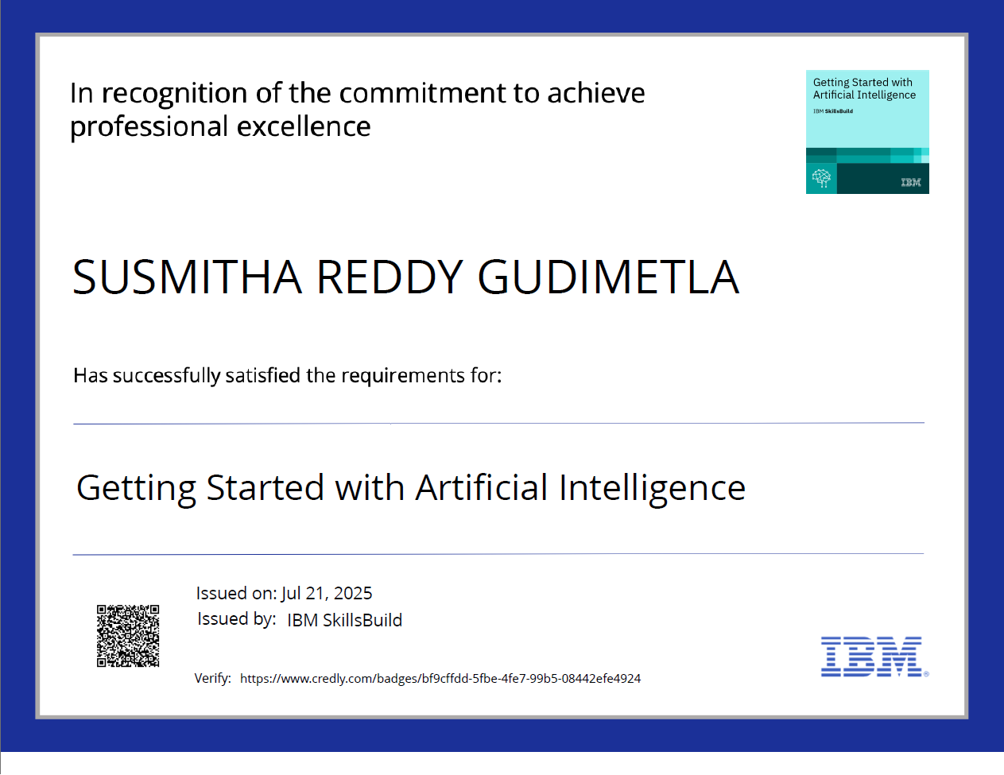

Slide 12
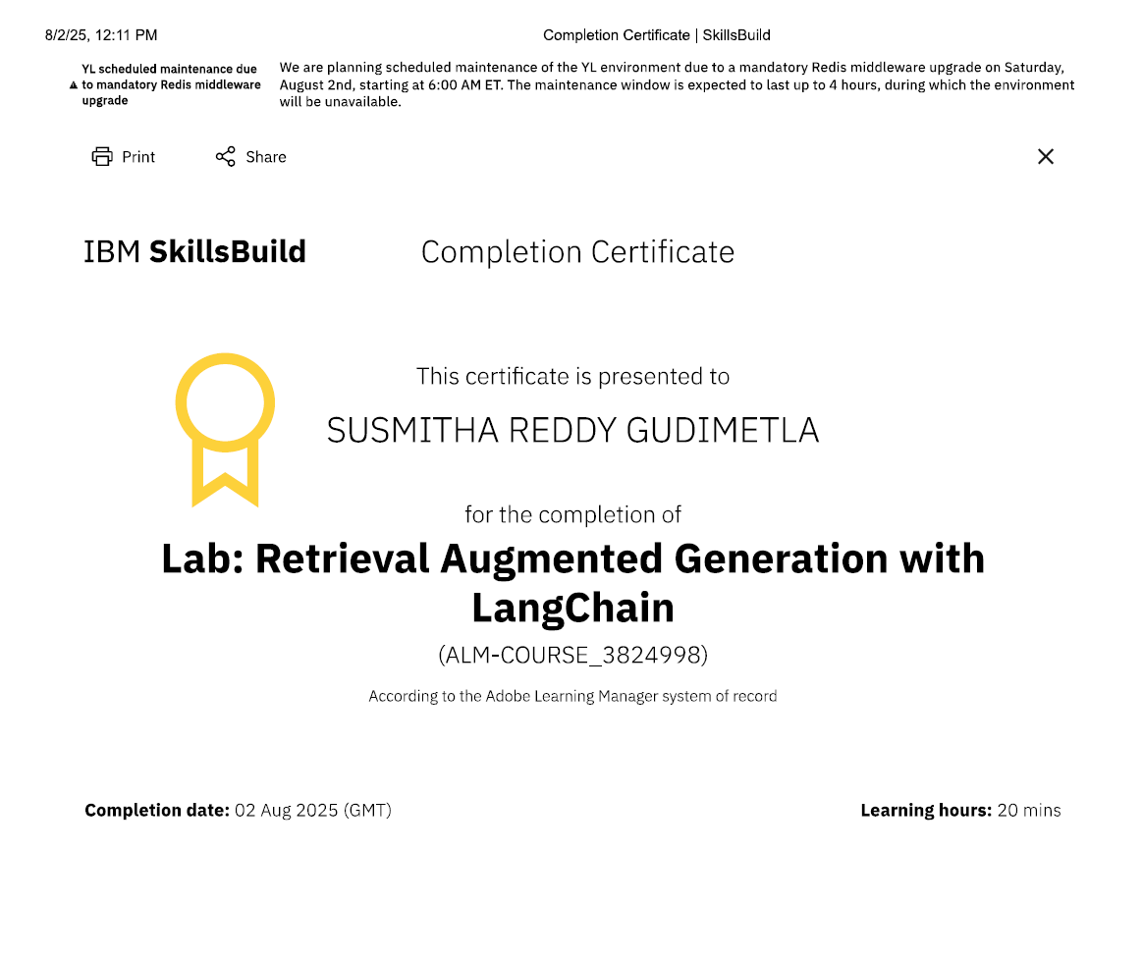

Slide 13
Thank You

